Slide 1
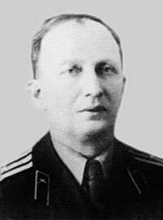
Семинар «Механика, управление и информатика», посвященный 100-летию со дня рождения П.Е. Эльясберга
Квазиспутниковые орбиты: свойства и возможные применения в астродинамике
В.В.Сидоренко (ИПМ им. М.В.Келдыша РАН)
А.В.Артемьев , А.И.Нейштадт, Л.М.Зеленый (ИКИ РАН)
Таруса, 2014

Slide 2
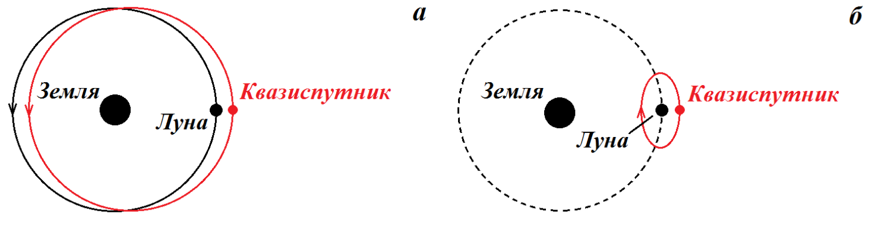
Квазиспутниковые орбиты
1:1 mean motion resonance!
Resonance phase ϕ=λ−λ’ librates around 0 (λ and λ’ are the mean longitudes of the asteroid and of the planet)
J. Jackson (1913) – the first(?) discussion of QS-orbits

Slide 3
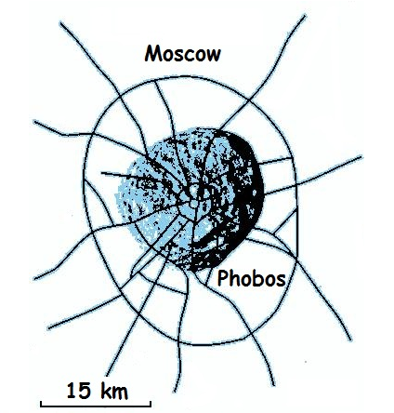
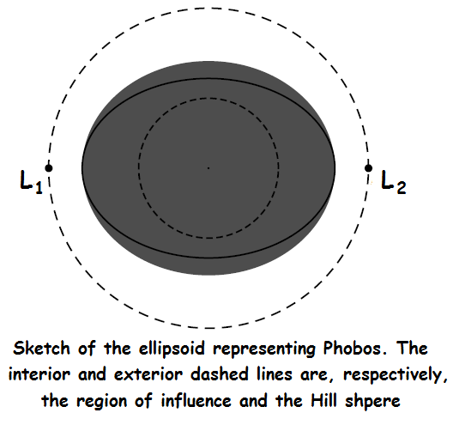
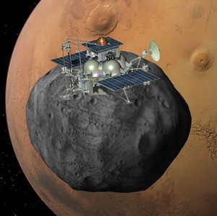
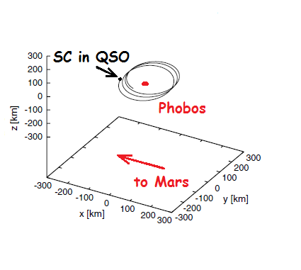
Quasi-satellite orbits
A.Yu.Kogan (1988), M.L.Lidov, M.A.Vashkovyak (1994) – the consideration of the QS-orbits in connection with the russian space project “Phobos”
Phobos – one of the Mars natural satellites
“Phobos-grunt” spacecraft

Slide 4
Quasi-satellite orbits
Namouni(1999) , Namouni et. al (1999), S.Mikkola, K.Innanen (2004),… - the investigations of the secular evolution in the case of the motion in QS-orbit
Real asteroids in QS-orbits:
2002VE68 – Venus QS;
2003YN107, 2004GU9, 2006FV35 – Earth QS;
2001QQ199, 2004AE9 – Jupiter’s QS
……………………

Slide 5
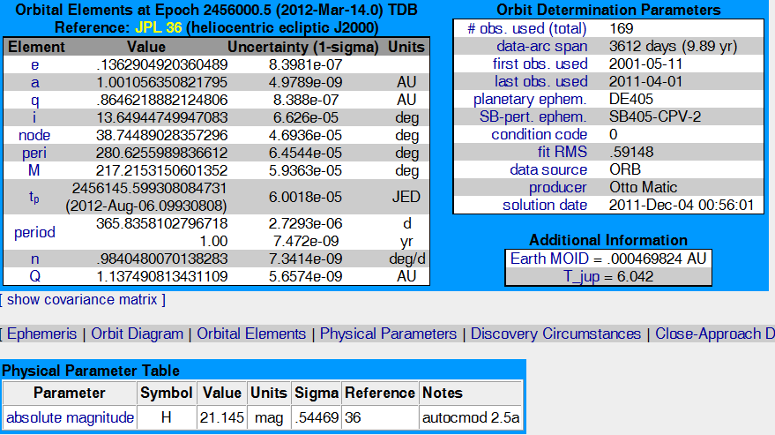
Asteroid 164207 (2004GU9)
No close encounters with Venus or Mars!

Slide 6
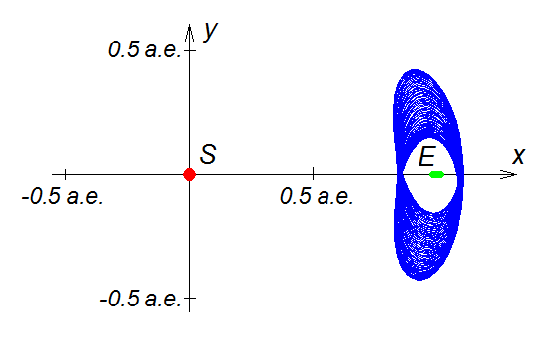
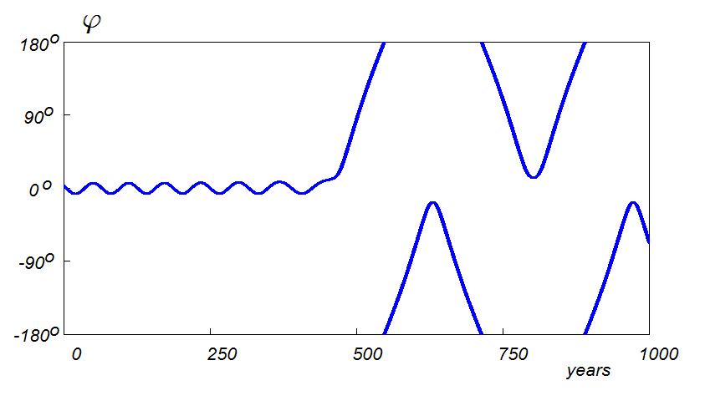
Asteroid 164207 (2004GU9)
Trajectory of the asteroid 2004GU9
Variation of the resonant phase

Slide 7
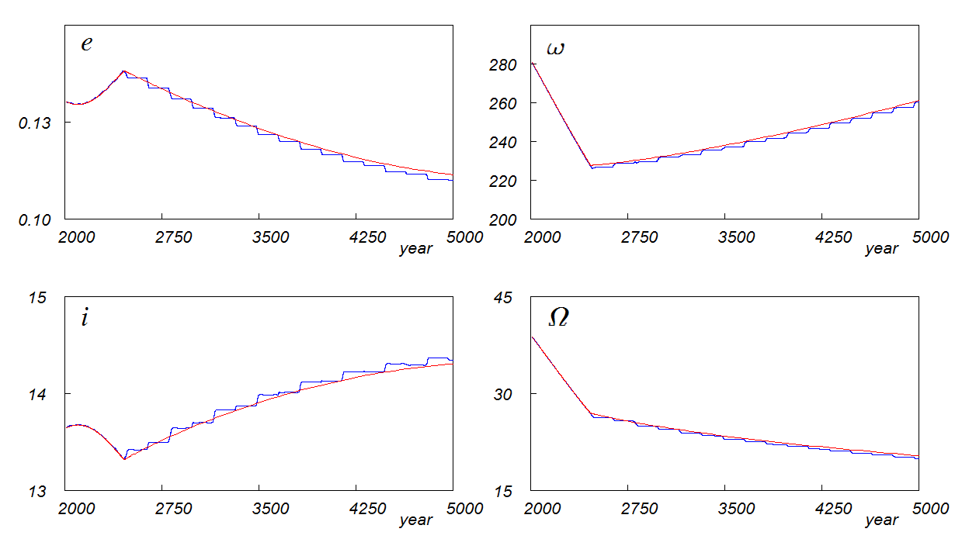
Asteroid 164207 (2004GU9 )
The evolution of the orbital elements (CR3BP!)

Slide 8
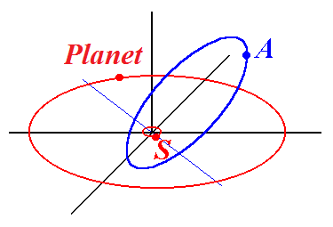
Model: nonplanar circular restricted
three-body problem “Sun-Planet-Asteroid”
- small parameter of the problem

Slide 9
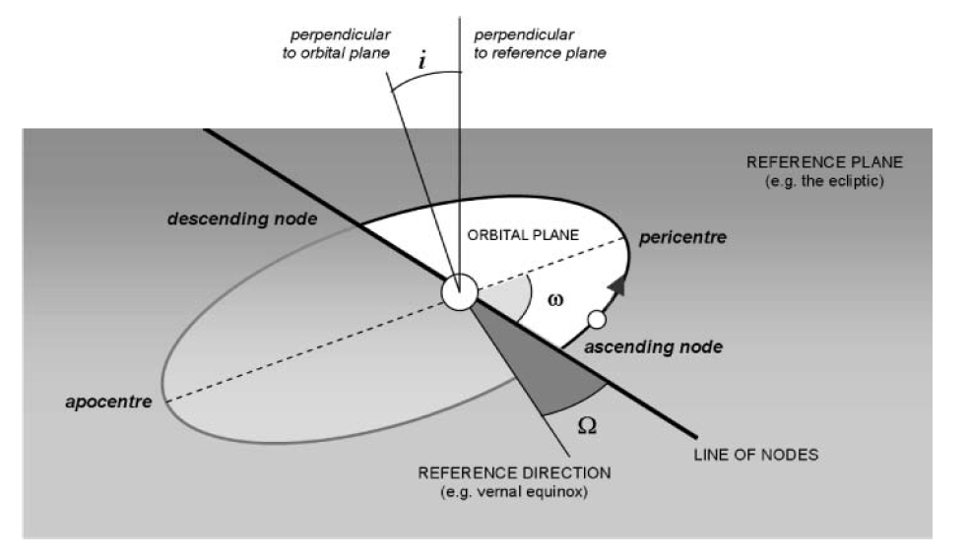
Orbital elements
- mean longitude

Slide 10
Nonplanar circular restricted
three-body problem “Sun-Planet-Asteroid”
Time scales at the resonance
T₁ - orbital motions periods
T₂ - timescale of rotations/oscillations of the resonant
argument (some combination of asteroid and planet
mean longitudes)
T₃ - secular evolution of asteroid’s eccentricity e,
inclination i, argument of prihelion ω and
ascending node longitude Ω .
T₁ << T₂ << T₃
Strategy: double averaging of the motion equations

Slide 11
Nonplanar circular restricted
three-body problem “Sun-Planet-Asteroid”
Initial variables (Delaunay coordinates):
First transformation:
where

Slide 12
Nonplanar circular restricted
three-body problem “Sun-Planet-Asteroid”
Hamiltonian of the problem:
where the disturbing function is

Slide 13
Nonplanar circular restricted
three-body problem “Sun-Planet-Asteroid”
Partition of the variables at 1:1 MMR:
“slow” variables
“semi-fast” variable
“fast” variable
First averaging – averaging over the fast variable :

Slide 14
Resonant approximation
Scale transformation
Slow variables
Slow-fast system
SF-Hamiltonian and symplectic structure
Fast variables
truncated averaged
disturbing function
approximate integral of the problem

Slide 15
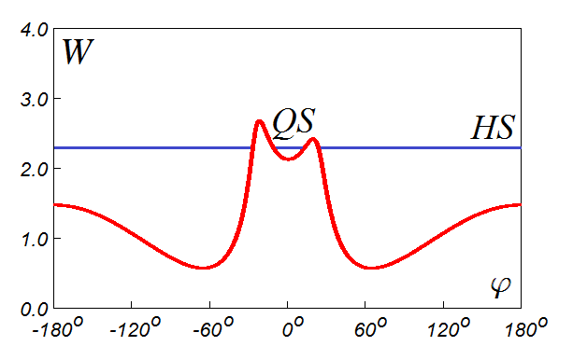
Averaging over the fast subsystem solutions on the level Н = ξ
Problem: what solution of the fast subsystem should be used for averaging ?
QS-orbit or HS-orbit?

Slide 16
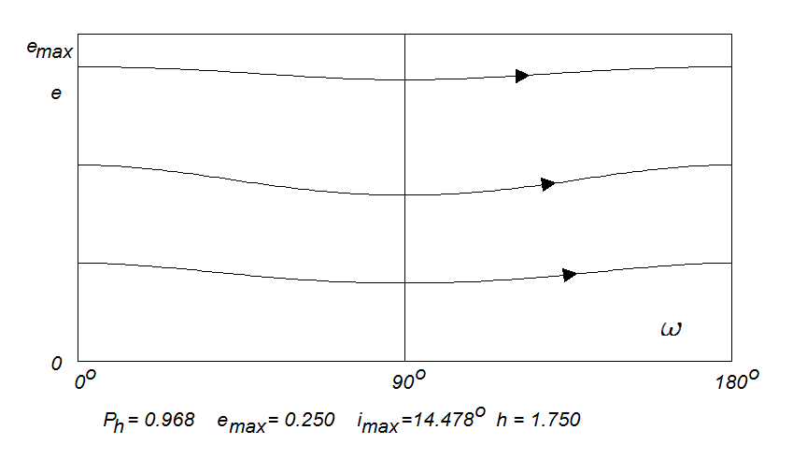
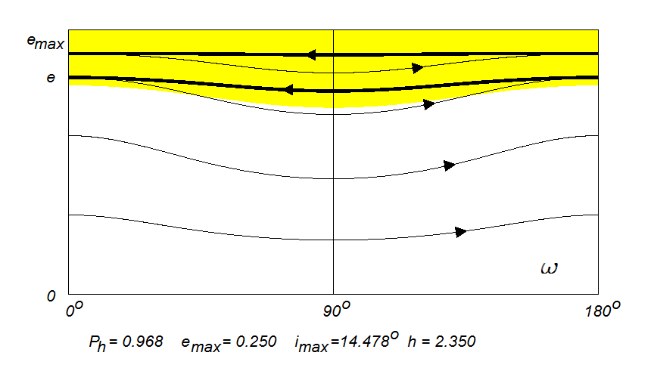
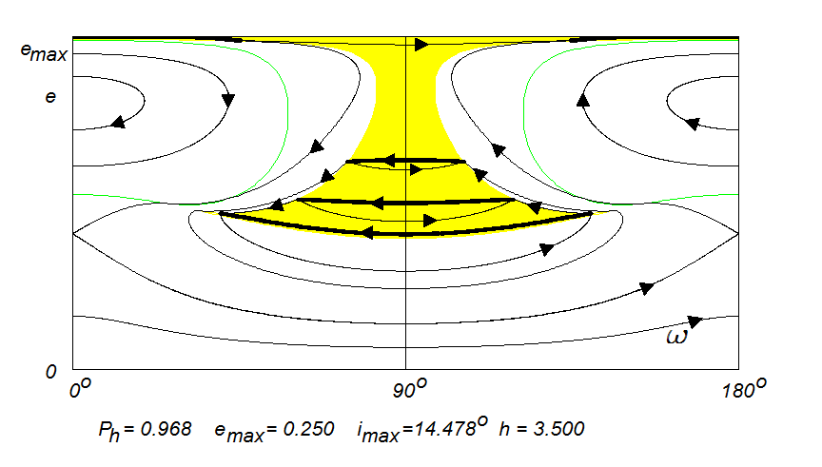
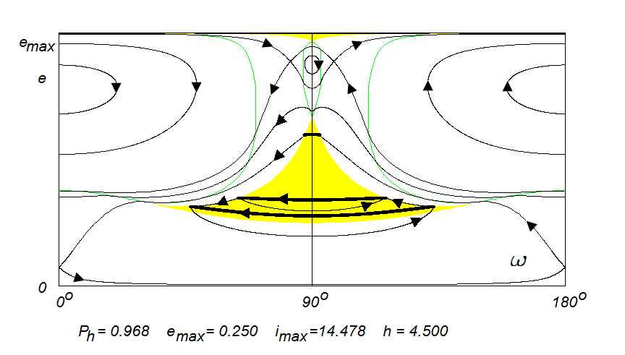
Secular effects: examples
Nonplanar circular restricted
three-body problem “Sun-Planet-Asteroid”
Parameters:

Slide 17
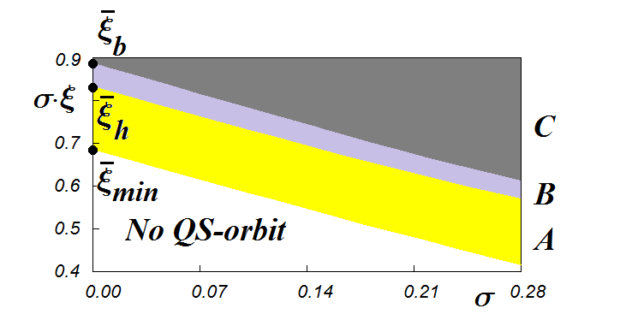
Scaling
A – the motion in QS-orbit is perpetual
B – the abundances of the perpetual and temporary QS-motions are more or less comparable
C- the motion in QS-orbit is mainly temporary

Slide 18
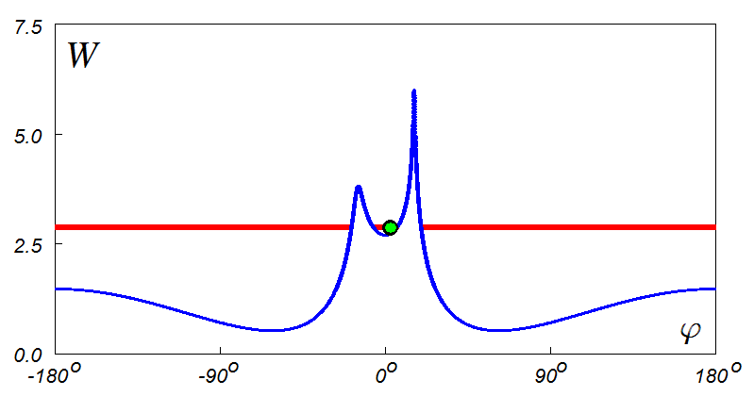
Asteroid 164207 (2004GU9)
Current and W
Variation of the resonant phase

Slide 19
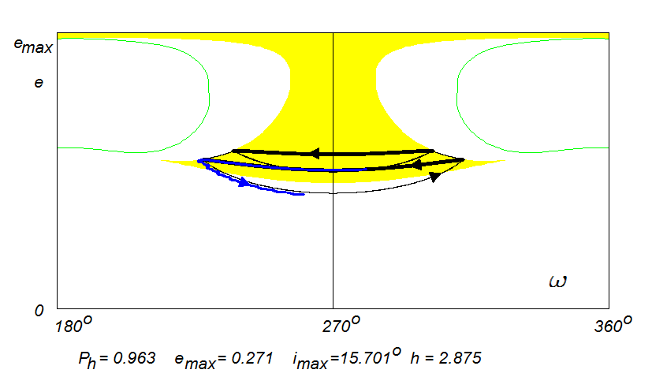
Asteroid 164207 (2004GU9)

Slide 20
Distant retrograde orbits in the Earth+Moon system
Preliminary investigation under the scope of CR3BP
Numerical investigation of SC dynamics in QS-orbit, taking into account the perturbation due to the solar gravity field
Main problem
The Moon’s Hill sphere has a radius of 60,000 km (1/6th of the distance between the Earth and Moon). So the QS-orbits outside Hill sphere are large enough and experience substantial perturbations from the Sun.

Slide 21
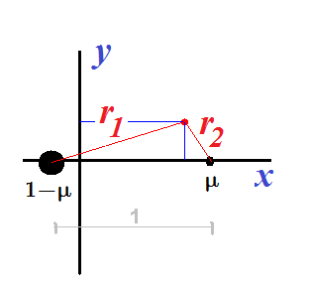
Preliminary investigation under the scope of planar CR3BP
Motion equations:
Synodic (rotating)
reference frame
Jacobi integral

Slide 22
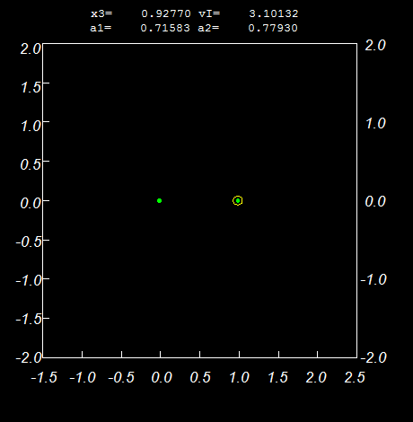
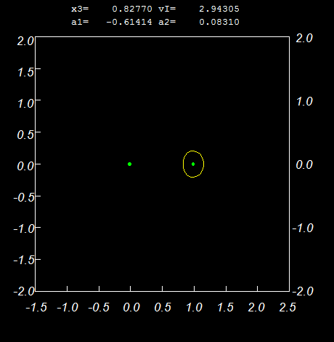
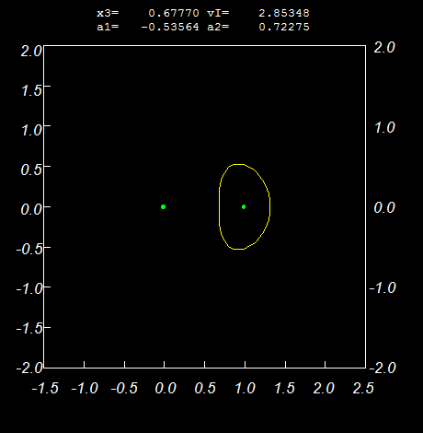
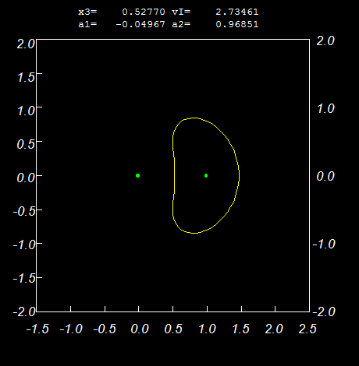
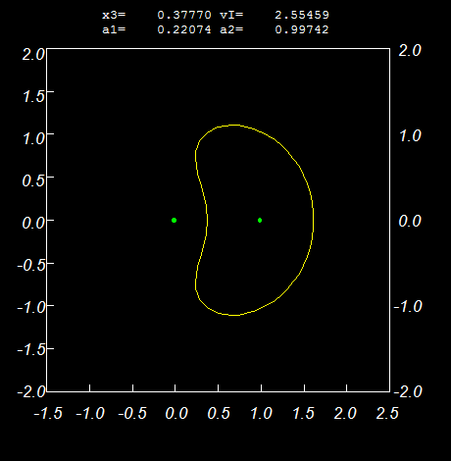
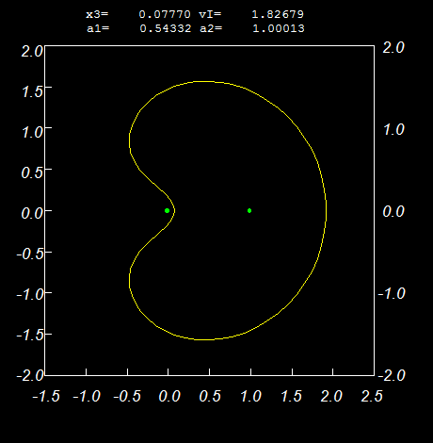
Distant retrograde periodic orbits (family f)

Slide 23
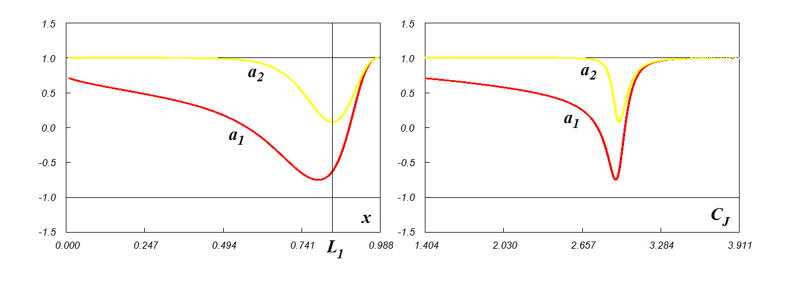
Distant retrograde periodic orbits (family f)
Stability indexes
Sufficient stability condition (under the linear approximation):

Slide 24
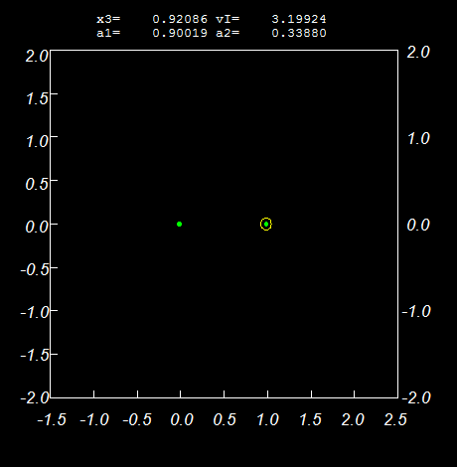
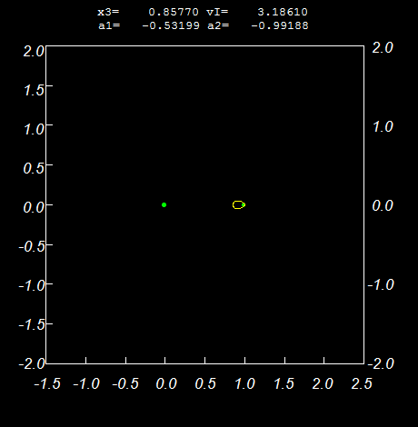
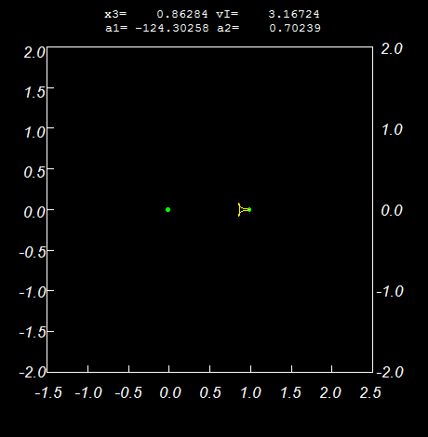
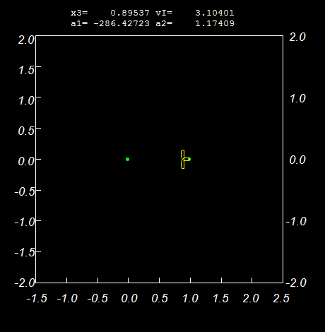
Direct periodic orbits (family h1)

Slide 25
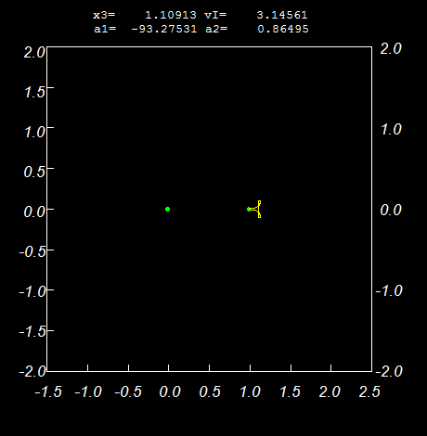
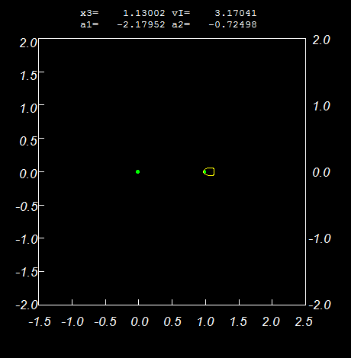

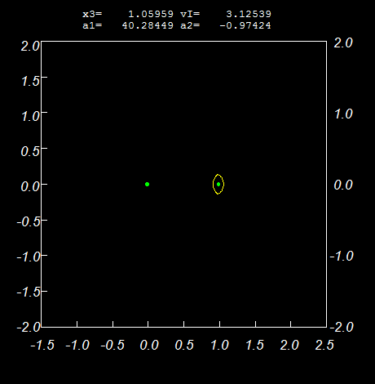
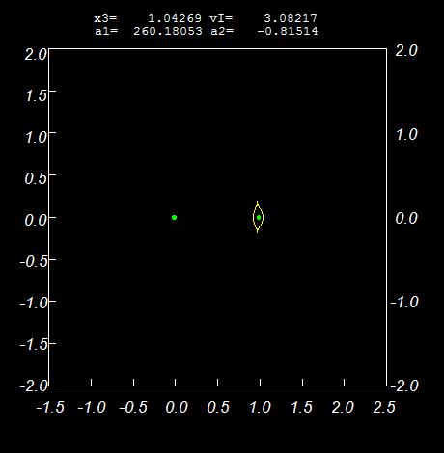
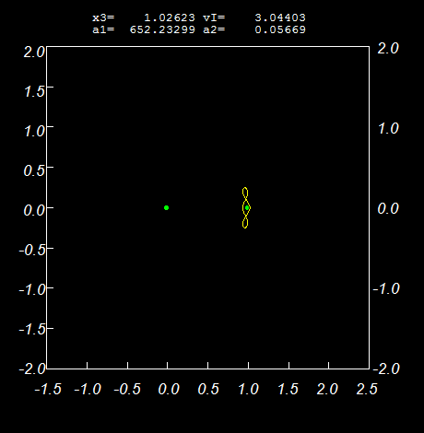
Direct periodic orbits (family h2)

Slide 26
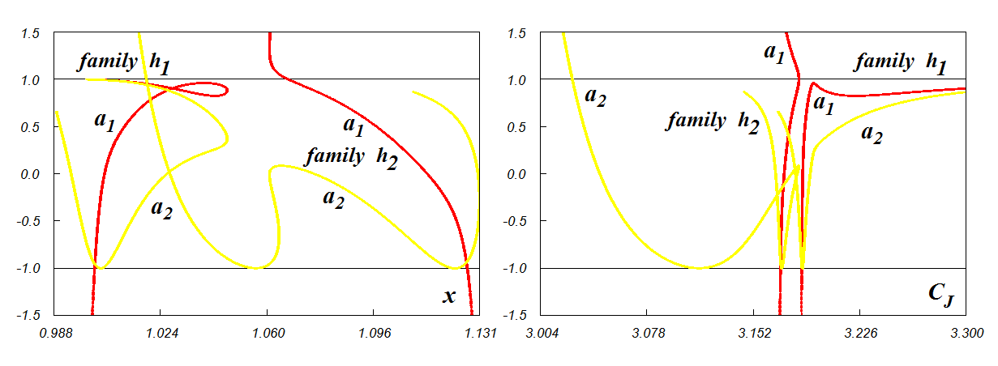
Direct periodic orbits
(families h1,h2)
Stability indexes
Sufficient stability condition (under the linear approximation):

Slide 27
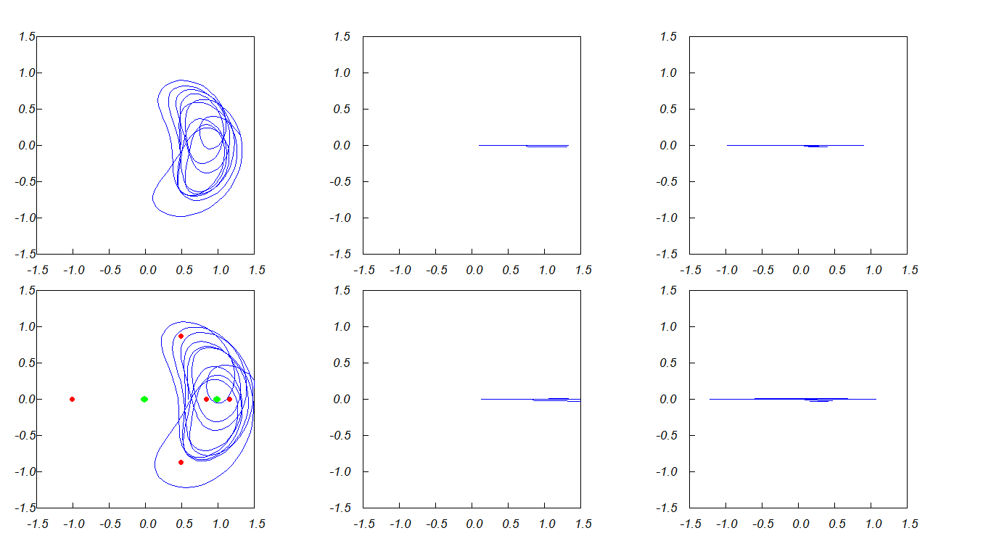
Numerical integration, taking into account the gravity fields and actual motion of Moon, Earth and Sun (JPL DE405)
180 days in QS-orbit
The initial distance to the moon - 40% of the distance Earth-Moon
The initial epoch – 01/06/2012

Slide 28
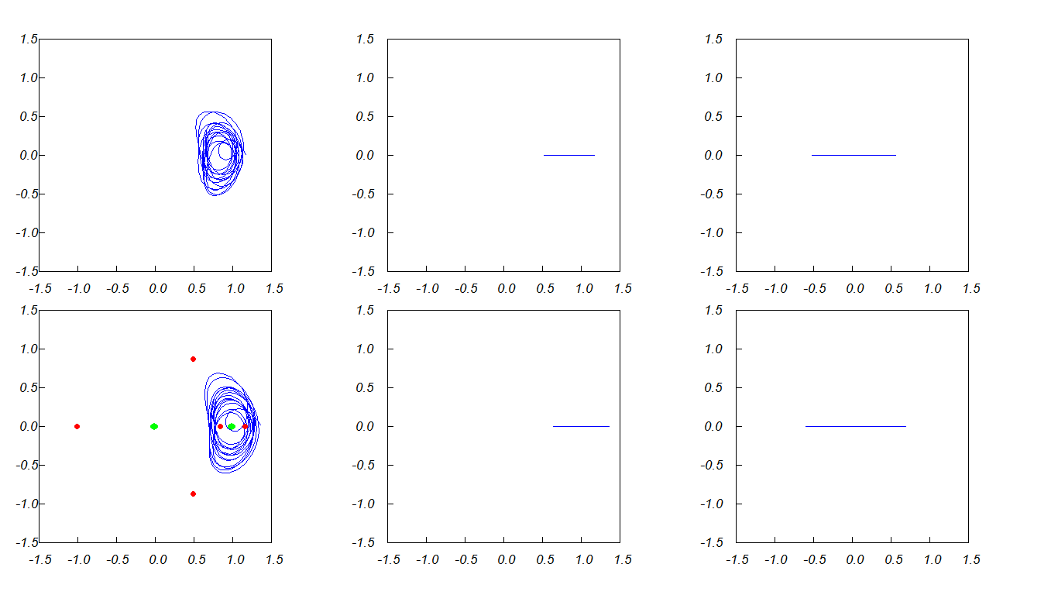
Numerical integration, taking into account the gravity fields and actual motion of Moon, Earth and Sun (JPL DE405)
270 days in QS-orbit
The initial distance to the moon - 30% of the distance Earth-Moon
The initial epoch – 01/06/2012

Slide 29
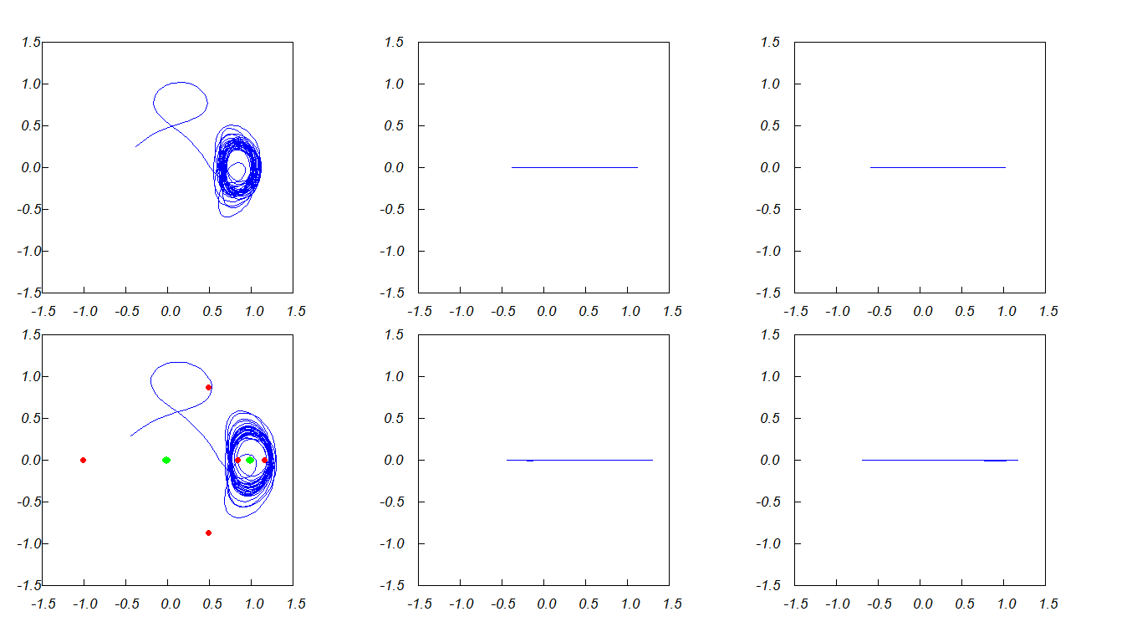
Numerical integration, taking into account the gravity fields and actual motion of Moon, Earth and Sun (JPL DE405)
1.5 year in QS-orbit
The initial distance to the moon - 25% of the distance Earth-Moon
The initial epoch – 01/06/2012

Slide 30
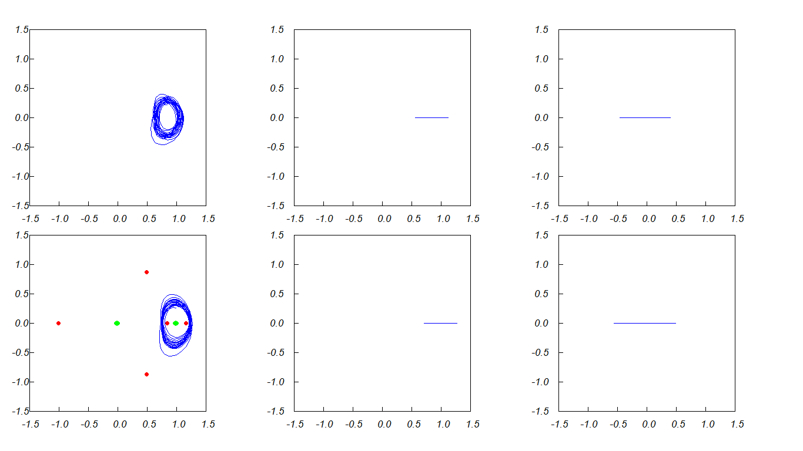
Numerical integration, taking into account the gravity fields and actual motion of Moon, Earth and Sun (JPL DE405)
First year in QS-orbit
The initial distance to the moon - 25% of the distance Earth-Moon
The initial epoch – 01/06/2012

Slide 31
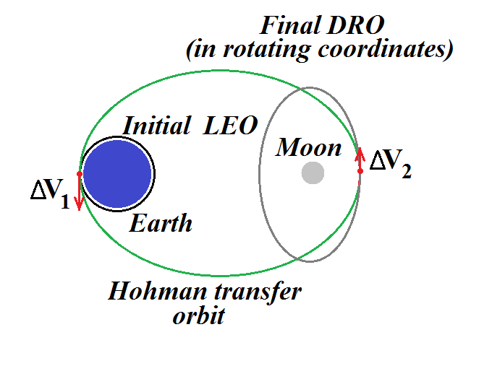
Transfer trajectories to DRO

Slide 32
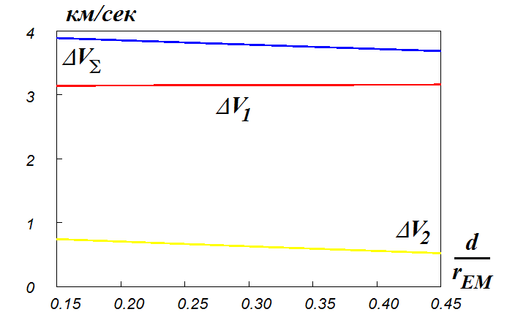
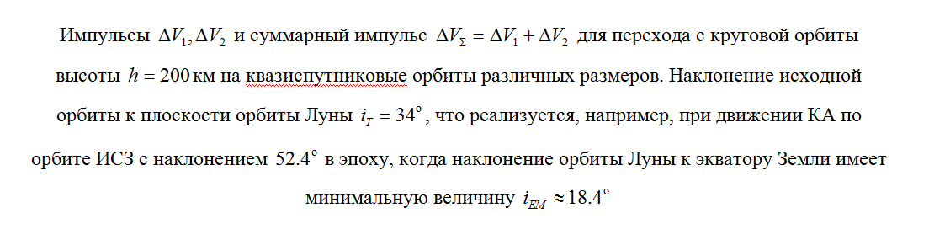
Transfer trajectories to DRO

Slide 33
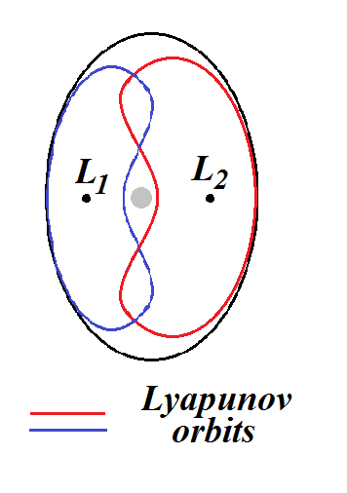
Transfer trajectories to DRO
Stable manifold of Lyapunov orbit as a transfer orbit?
X.Ming, X.Shijie (2009)

Slide 34
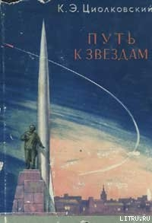
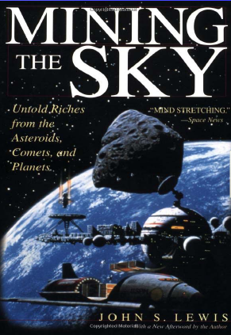
Применение квазиспутниковых орбит для «хранения» астероидов
Циолковский: Исследование мировых пространств реактивными приборами (дополнение 1911-1912 гг)
эксплуатация ресурсов астероидов
Lewis, 1996

Slide 35
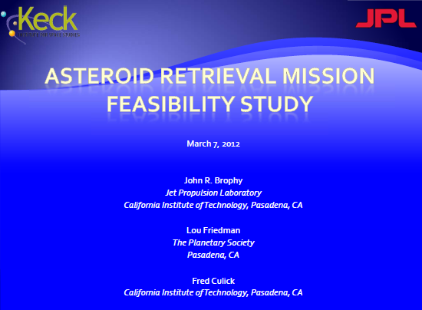
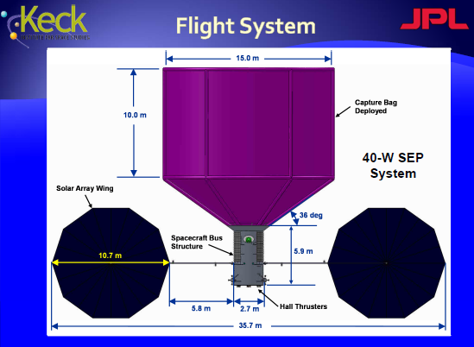

Перемещение астероидов в окрестность Земли
www.planeatryresources.com

Slide 36

Спасибо за внимание!

