Slide 1

Electronic structure and Auger recombination rates in silicon nanocrystals doped with P, Li, S
N.V. Derbeneva, V.A. Burdov
Lobachevsky State University of Nizhniy Novgorod

Slide 2
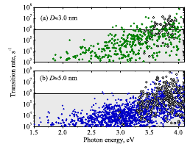
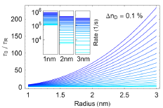
Published data by other authors on radiative recombination lifetimes
Relative rate of the radiative recombination as a function of the dot radius at donor (P) concentration with the constant step 0.1% from 0 to 2%/ Inset shows absolute values of the rate for three Si nanocrystals with different radii indicated in the inset
Calculated rates for direct radiative recombination. Panels a) and b) were calculated for NCs with different diameters
A.N. Poddubny, A.A. Prokoﬁev, and I.N. Yassievich
Optical transitions and energy relaxation
of hot carriers in Si nanocrystals
APL, V. 97, P. 231116 (2010)
V.A. Belyakov, V.A. Burdov et al. Tunnel migration in ensembles of silicon nanocrystals doped with phosphorus
J. Of Phys.: Conf. Ser., V. 245,
P. 012039 (2010)

Slide 3
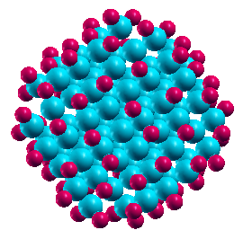
Modeling nanocrystal structure and computational method
Dangling bonds on the nanocrystal’s boundary were saturated with hydrogen;
The relaxation of the crystal structure of the nanocluster was performed by minimizing the appropriate modules of the forces acting on each of the atoms from the other atoms using conjugate gradient method;
Calculation of nanocluster’s electron and hole states was performed within the density functional theory based on the self-consistent calculation of the electron density and the total energy of the system using the software package OCTOPUS;
Exchange-correlation term was used in the form of generalized-gradient approximation PBE model;
Vanishing wave function on the surface of the crystallite was applied as a boundary condition.
Si₈₇H₇₆
D=1.4 нм

Slide 4
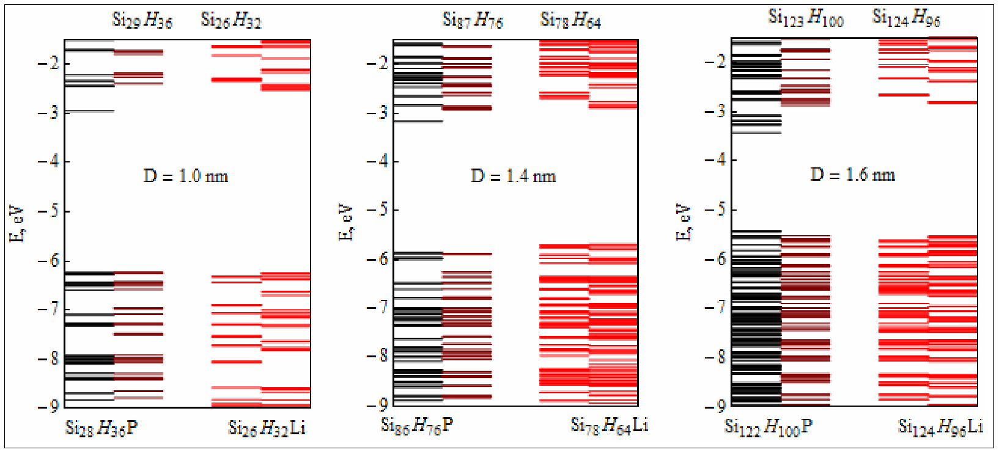
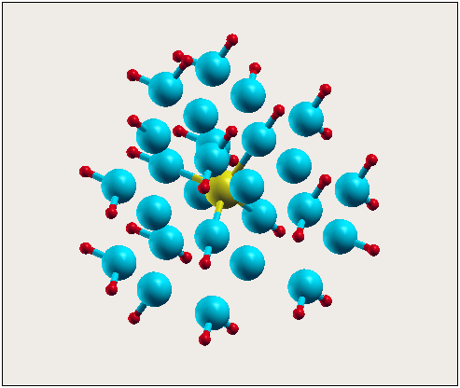



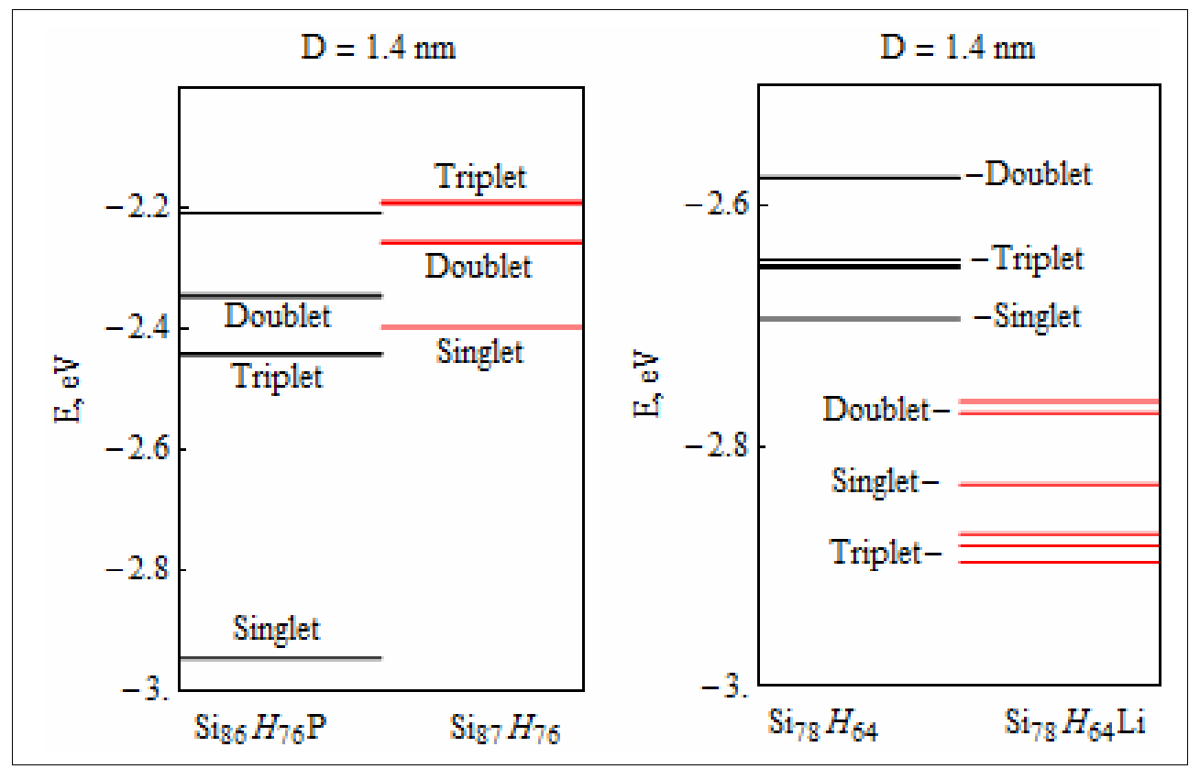

Electronic structure of Si-nc, doped with P, Li
- Si
- H
- Li
Si₂₆Li₁H₃₂
D=1.0 нм
Hohenberg P., Kohn W., Phys. Rev. 136, B864 (1964)
Kohn W., Sham L.J., Phys. Rev. 140, A1133 (1965)
Calculations were performed using the software package OCTOPUS
X. Andrade et al. J. Phys.: Cond. Matt., 24, 233202 (2012).

Slide 5
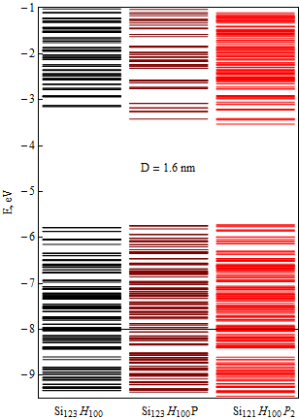
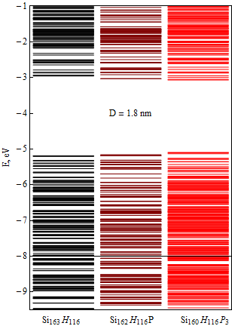
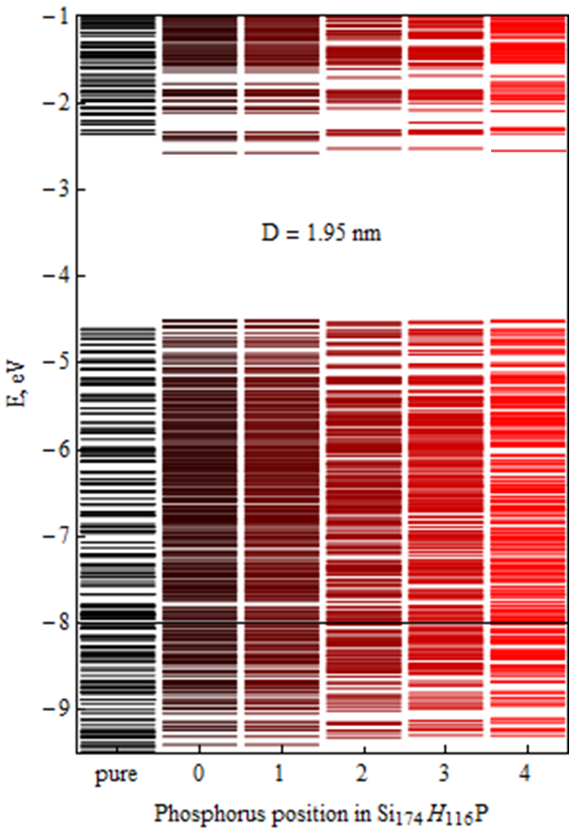
Electronic structure of silicon nanocrystals doped with several phosphorus atoms (n_{D}=2%)
Electronic structure of silicon nanocrystal with diameter equivalent to 1.95 nm doped with one phosphorus atom depending on its position in the crystalline

Slide 6
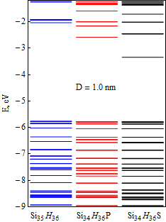
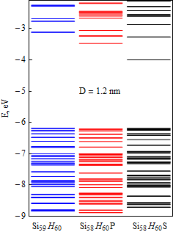
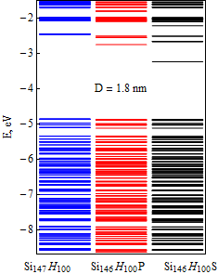
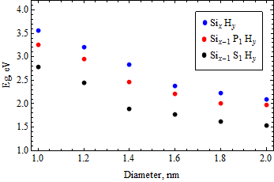
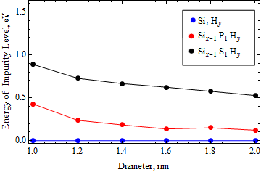
Electronic structure of silicon nanocrystals doped with P, S
Electronic structure of Si-nc, doped with P, S
Relation between impurity energy level and the nanocrystal diameter
Relation between HOMO-LUMO
gap and the nanocrystal diameter

Slide 7
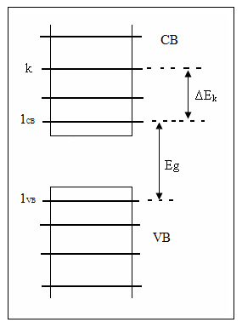
Mechanism of the
Auger recombination process
Fermi’s Golden Rule:
Matrix element of the Auger transition:
A transition condition:
Electron-electron interaction potential:

Slide 8
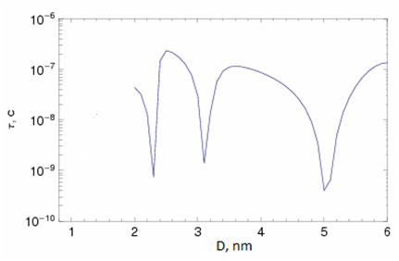
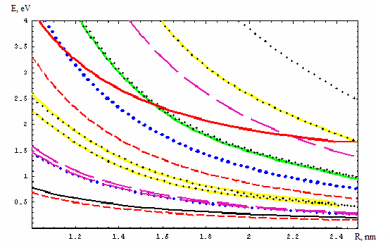
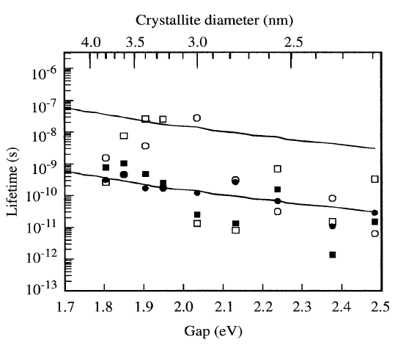
Auger recombination rates in pure silicon nanocrystals with diameter from 2 to 6 nm (the k-p method)
Calculation was performed using electronic spectrum and wavefunctions obtained within the kp-method
Eleectronic structure of silicon nanocrystals obtained within the kp-method as a function of nanocrystalline radius
Delerue C., Lannoo M., Allan G. et al.,
Phys. Rev. Lett. 75, 2228 (1995).

Slide 9
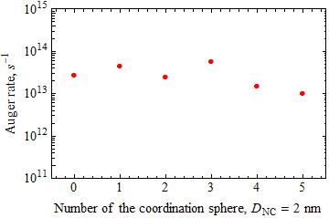
Auger recombination rates for nanocrystal with diameter of 1.95 nm as a function of the phosphorus position inside the nanocrystal

Slide 10
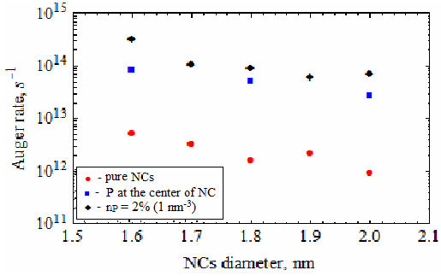

Auger recombination rate in silicon nanocrystals in the presence of donors
Auger recombination rates as a function of phosphorus concentration and nanocrystal diameter
Auger recombination rates in nanocrystals doped with Lithium depending on the crystalline diameter

Slide 11






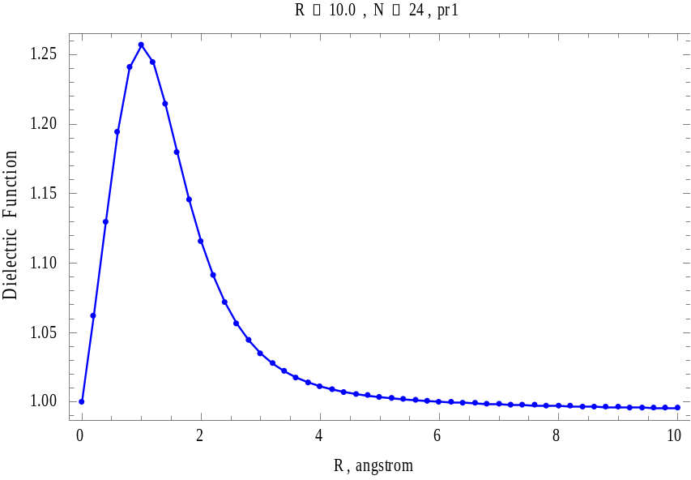
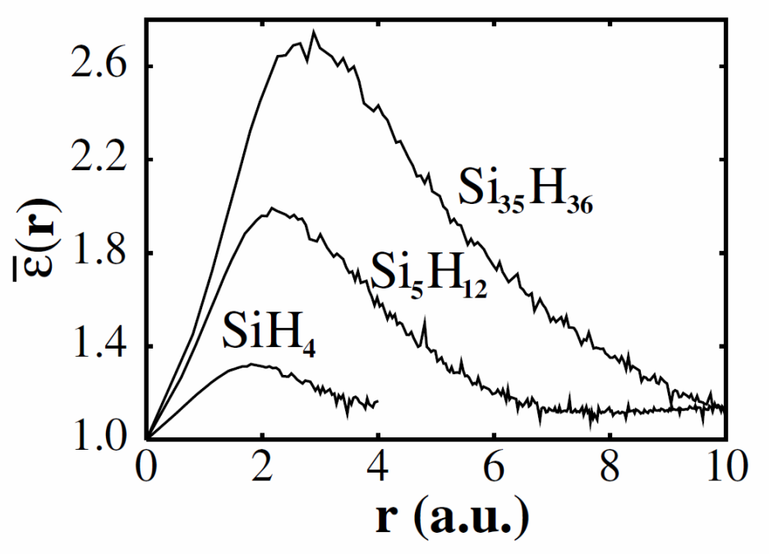
Dielectric function in silicon nanocrystals
SiH₄
R, angstrom
J.R. Chelikowsky et. al. PRL 90, 127401

Slide 12
Conclusion
The electronic structure calculation for silicon nanocrystals with diameters 1-2 nm was performed within density functional theory for two cases: pure crystallites and doped with P, Li, S.
It was shown that the presence of the lithium atom has a significantly less strong influence on the spectrum of the nanocrystal than the presence of phosphorus which leads to a strongly cleaved singlet level, that in turn leads to a noticable decrease of the HOMO-LUMO gap of the nanocrystal. We also can see that in the presence of the lithium atom decreasing the width of the HOMO-LUMO gap of the nanocrystals also takes place. However it is much weaker and is achieved through the elimination of the triplet level.
It was shown that the sulfur quite strongly modifies the electronic structure of a crystalline, resulting in reducing of the primary electron-hole junction energy by about 15 - 20% in comparison with pure nanocrystals and 10 - 15% in comparison with phosphorus-doped nanocrystals.
In the presence of donor Auger recombination rate increases, and the calculations show that phosphorus has mach more influence on the Auger transition rates than lithium, which can be associated with stronger central cell potential of the phosphorus ion.

Slide 13
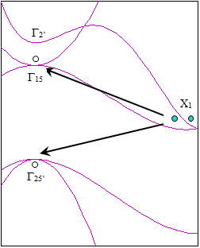
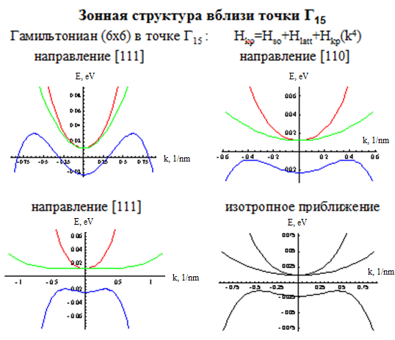
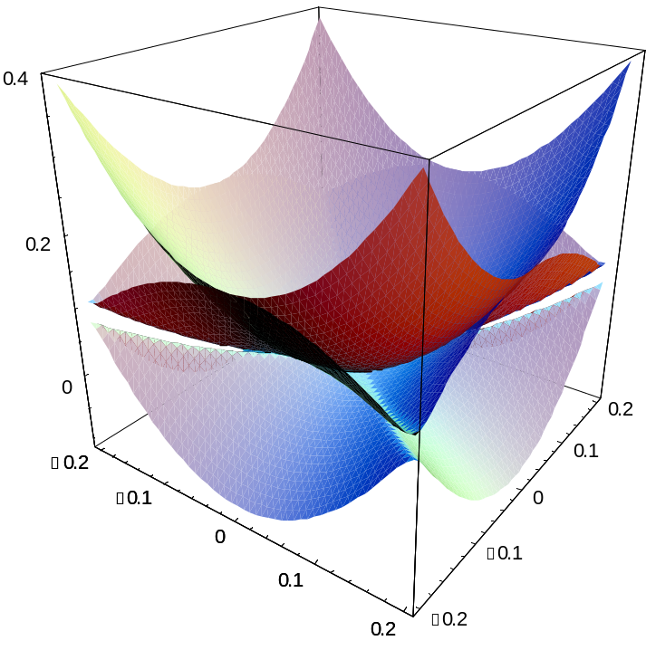
Band strurcture near Г₁₅ in bulk silicon

