Slide 1
Isentropic “shock waves” in numerical astrophysical simulations
G.S.Bisnovatyi-Kogan, S.G.Moiseenko
IKI RAN

Slide 2

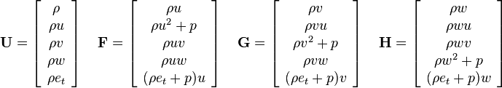

Euler equations
Mass conservation
Momentum conservation
Energy conservation
Usually set of hyperbolic partial differential equations
Divergent form of equations
e_{t} is the total energy
(internal energy + kinetic energy + potential energy)
per unit mass

Slide 3
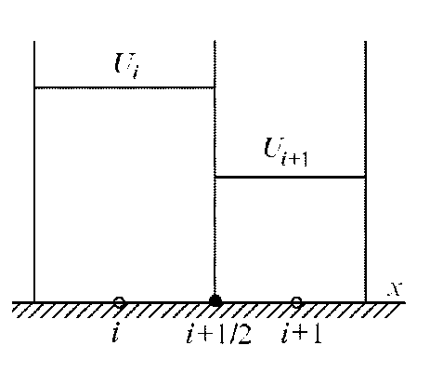
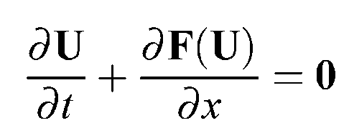
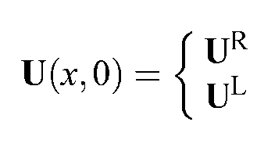
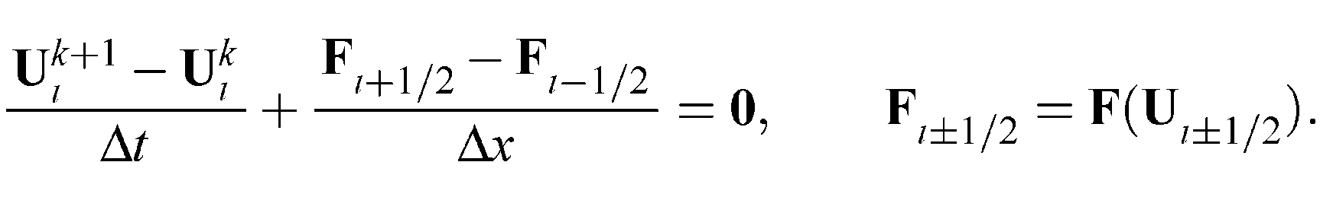
Typical numerical method can be written in the form:
, for x >0,
, for x <0.

Slide 4

When the gas from is strongly supersonic and cold: E_{internal} << E_{kinetic}
To calculate pressure P or temperature T we need to subtract two big numbers.
This is a source of numerical errors.
Negative pressure or temperature can be easily obtained.
$${ρe^{k+1}}_{t,i}−{ρe^{k}}_{t,i}$$

Slide 5
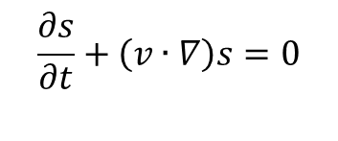
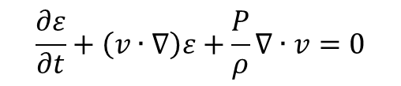
To avoid this difficulty instead of the energy conservation equation
the conservation entropy equation is used.
$$\frac{∂ε}{∂t}+\left(v∙∇\right)ε+\frac{P}{ρ}∇∙v=0$$
$$\frac{∂s}{∂t}+\left(v∙∇\right)s=0$$
We tried to estimate possible consequences of such step quantitatively.
When there are no shocks in the flow it is correct substitution.
Isentropic set of hydro equations is also hyperbolic in time.
Isentropic strong discontinuities =‘isentropic shock waves’ exists.

Slide 6
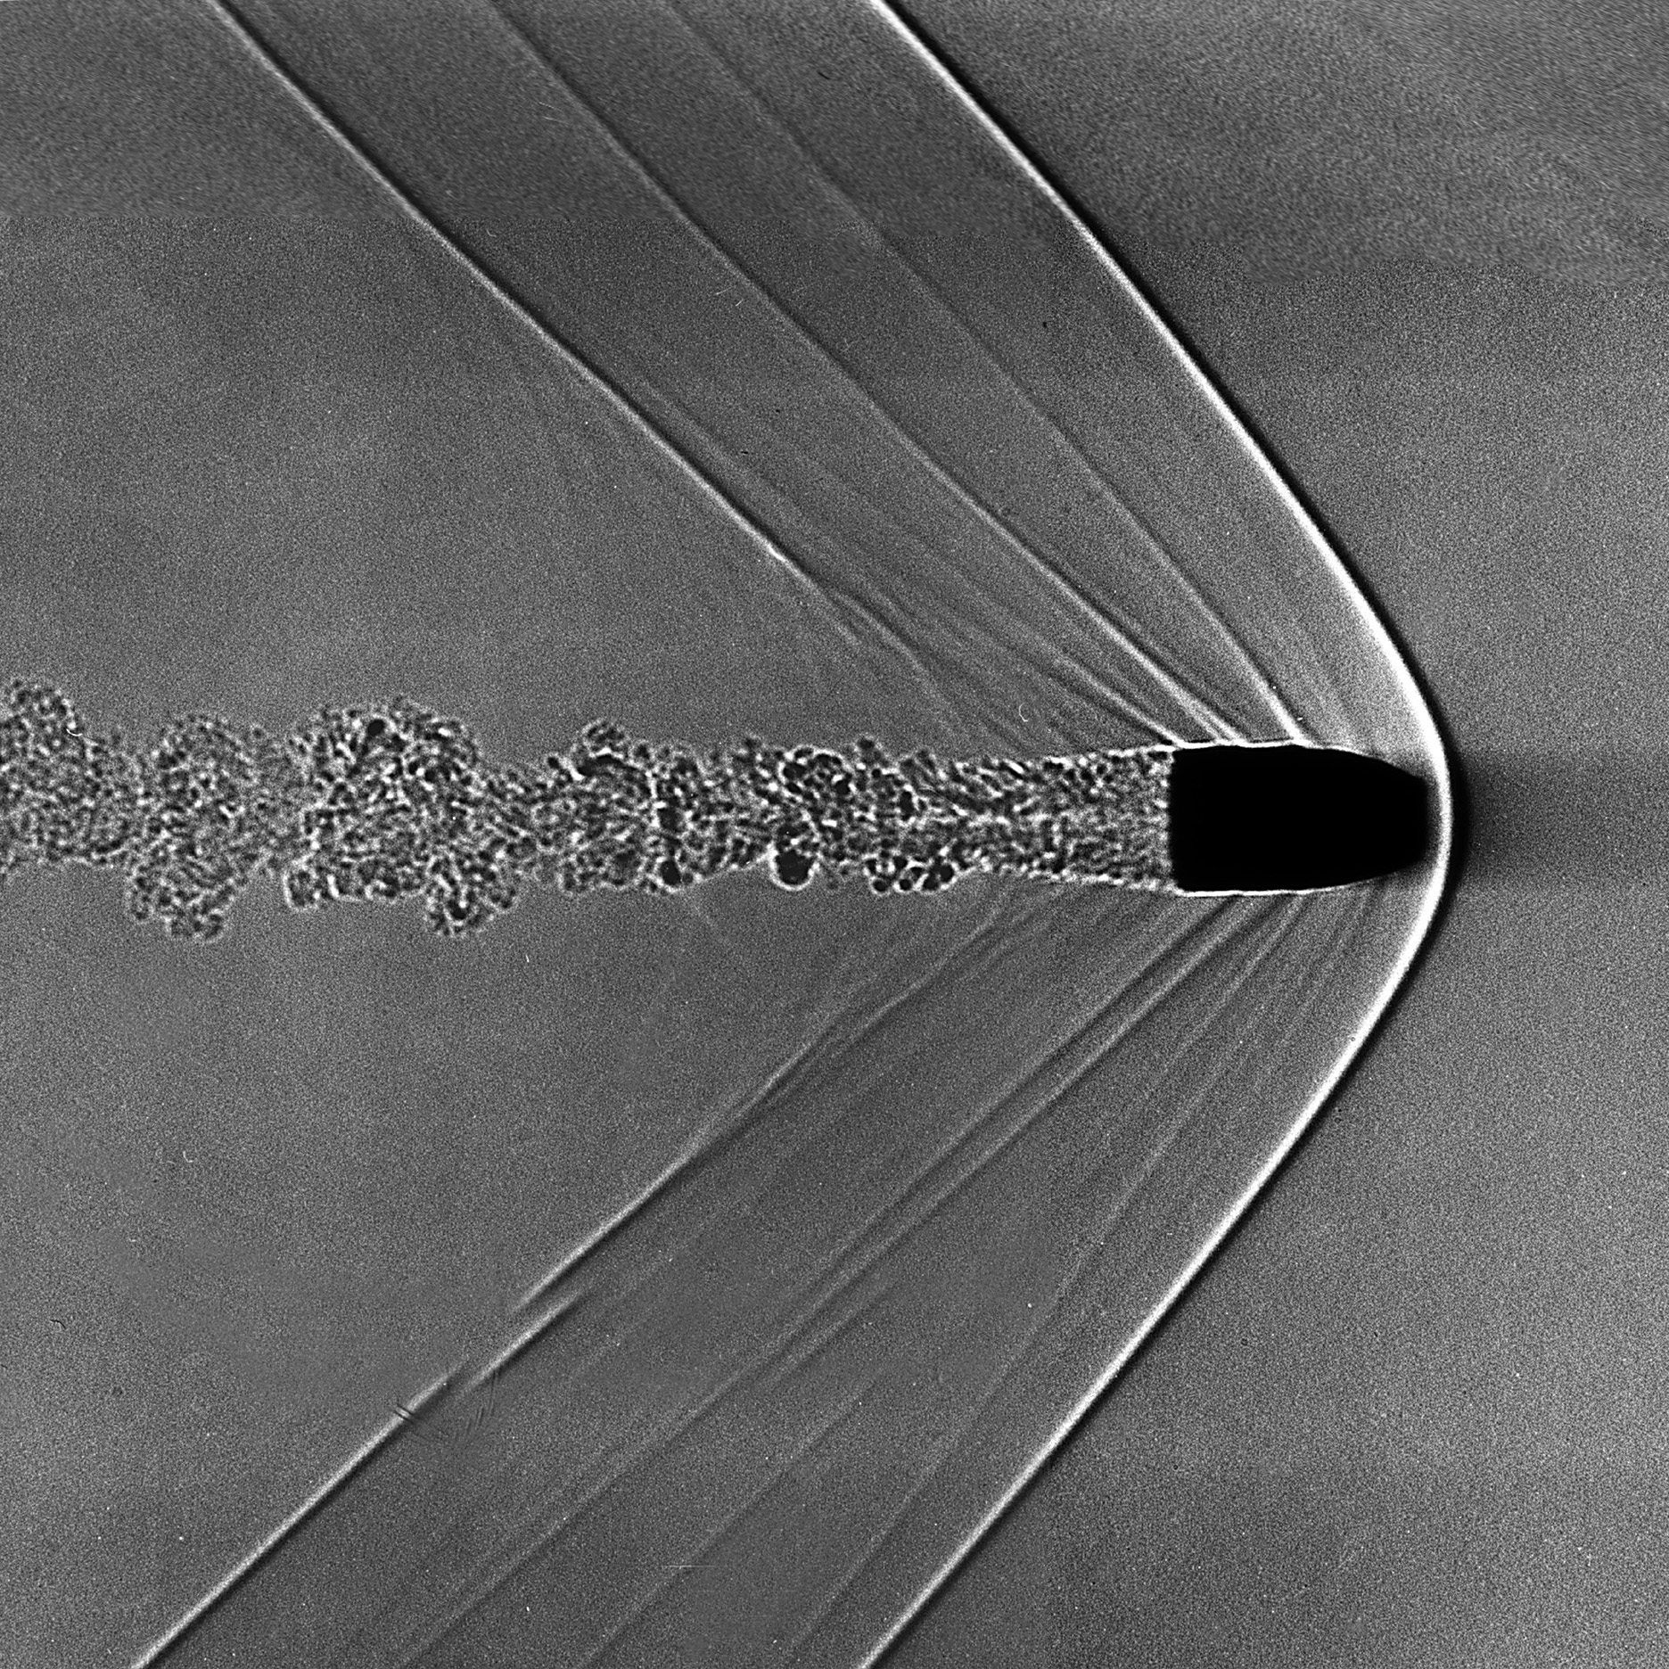
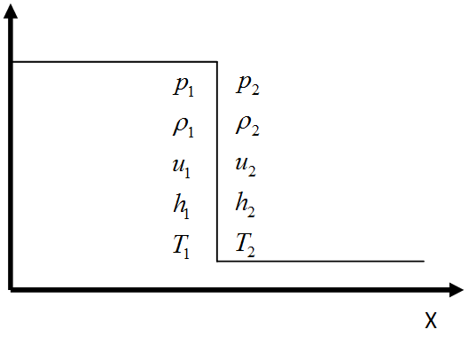



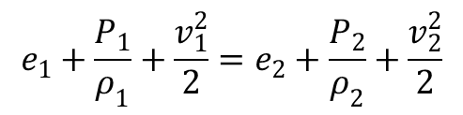

Shock wave
Rankine-Hugoniot conditions:
$$ρ_{1}v_{1}=ρ_{2}v_{2},$$
$$P=K(S)ρ^{γ}$$
Equation of state
$$P_{1}+ρ_{1}v_{1}^{2}=P_{2}+ρ_{2}v_{2}^{2},$$
e$=\frac{1}{γ−1}\frac{P}{ρ}=\frac{K(S)}{γ−1}ρ^{γ−1}$
Internal energy
$$e_{1}+\frac{P_{1}}{ρ_{1}}+\frac{v_{1}^{2}}{2}=e_{2}+\frac{P_{2}}{ρ_{2}}+\frac{v_{2}^{2}}{2}$$

Slide 7
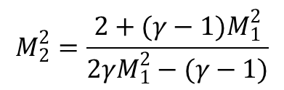
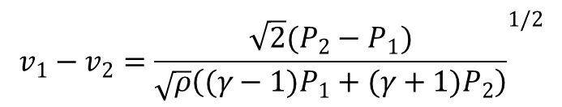
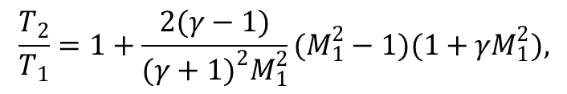

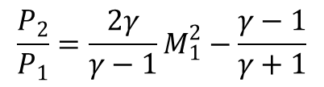
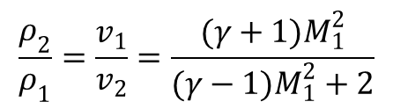

Hugoniot adiabat: $\frac{P_{2}}{P_{1}}=\frac{(γ+1)ρ_{2}−(γ−1)ρ_{1}}{(γ+1)ρ_{1}−(γ−1)ρ_{2}}$
Index ‘1’ – before the shock,
‘2’ – after the shock
Relations between parameters before and after the shock:
$$v_{1}−v_{2}={\frac{\sqrt{2}(P_{2}−P_{1})}{\sqrt{ρ}\left((γ−1)P_{1}+(γ+1)P_{2}\right)}}^{1/2}$$
$M_{1}=\frac{v_{1}}{c_{1}}$ - Mach number before the shock.
$$\frac{ρ_{2}}{ρ_{1}}=\frac{v_{1}}{v_{2}}=\frac{(γ+1)M_{1}^{2}}{(γ−1)M_{1}^{2}+2}$$
$$\frac{P_{2}}{P_{1}}=\frac{2γ}{γ−1}M_{1}^{2}−\frac{γ−1}{γ+1}$$
$$\frac{T_{2}}{T_{1}}=1+\frac{2(γ−1)}{(γ+1)^{2}M_{1}^{2}}(M_{1}^{2}−1)(1+γM_{1}^{2}),$$
$$M_{2}^{2}=\frac{2+(γ−1)M_{1}^{2}}{2γM_{1}^{2}−(γ−1)}$$

Slide 8
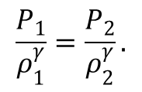
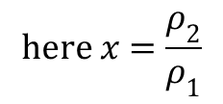
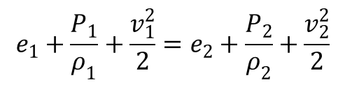
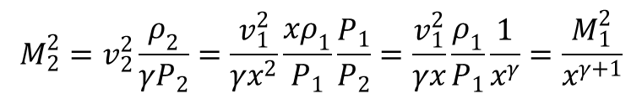
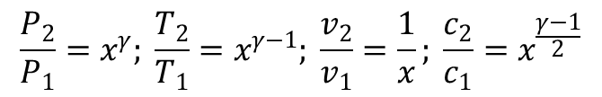
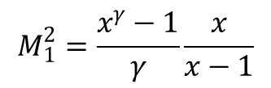
For isentropic case:
$$e_{1}+\frac{P_{1}}{ρ_{1}}+\frac{v_{1}^{2}}{2}=e_{2}+\frac{P_{2}}{ρ_{2}}+\frac{v_{2}^{2}}{2}$$
$$\frac{P_{1}}{ρ_{1}^{γ}}=\frac{P_{2}}{ρ_{2}^{γ}}.$$
Instead
we use
Instead of Hugoniot relations we get relations for ‘isentropic shock’:
$$\text{here} x=\frac{ρ_{2}}{ρ_{1}}$$
$$M_{1}^{2}=\frac{x^{γ}−1}{γ}\frac{x}{x−1}$$
$$\frac{P_{2}}{P_{1}}=x^{γ}; \frac{T_{2}}{T_{1}}=x^{γ−1}; \frac{v_{2}}{v_{1}}=\frac{1}{x}; \frac{c_{2}}{c_{1}}=x^{\frac{γ−1}{2}}$$
$$M_{2}^{2}=v_{2}^{2}\frac{ρ_{2}}{γP_{2}}=\frac{v_{1}^{2}}{γx^{2}}\frac{xρ_{1}}{P_{1}}\frac{P_{1}}{P_{2}}=\frac{v_{1}^{2}}{γx}\frac{ρ_{1}}{P_{1}}\frac{1}{x^{γ}}=\frac{M_{1}^{2}}{x^{γ+1}}$$

Slide 9
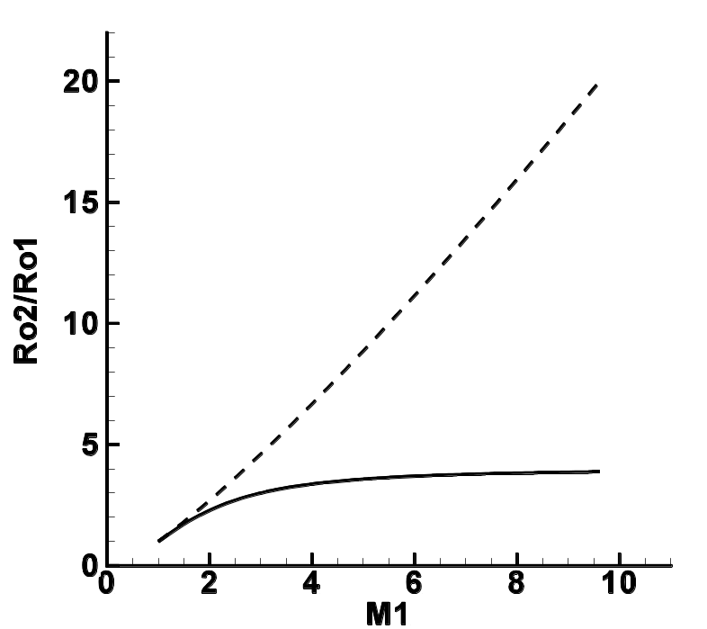
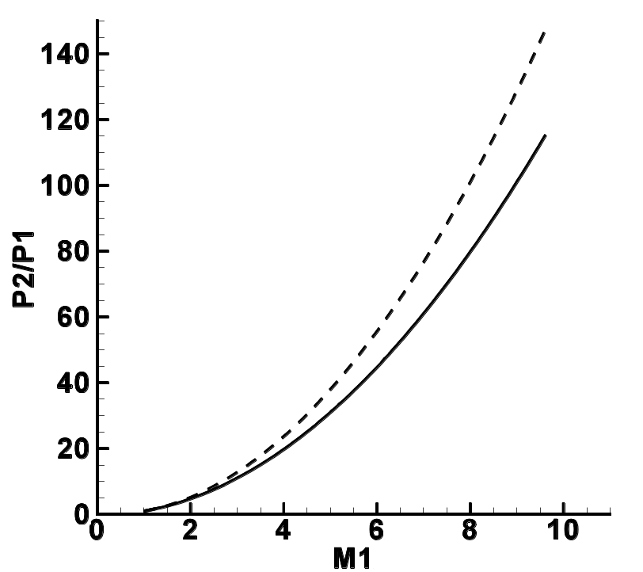


Plots for $x=\frac{ρ_{2}}{ρ_{1}}\left(M_{1}\right), \frac{P_{2}}{P_{1}}\left(M_{1}\right), \frac{T_{2}}{T_{1}}\left(M_{1}\right)$, $\frac{v_{2}}{v_{1}}\left(M_{1}\right)$
$$γ=5/3$$
For Hugoniot adiabat and for ‘isentropic shock’

Slide 10
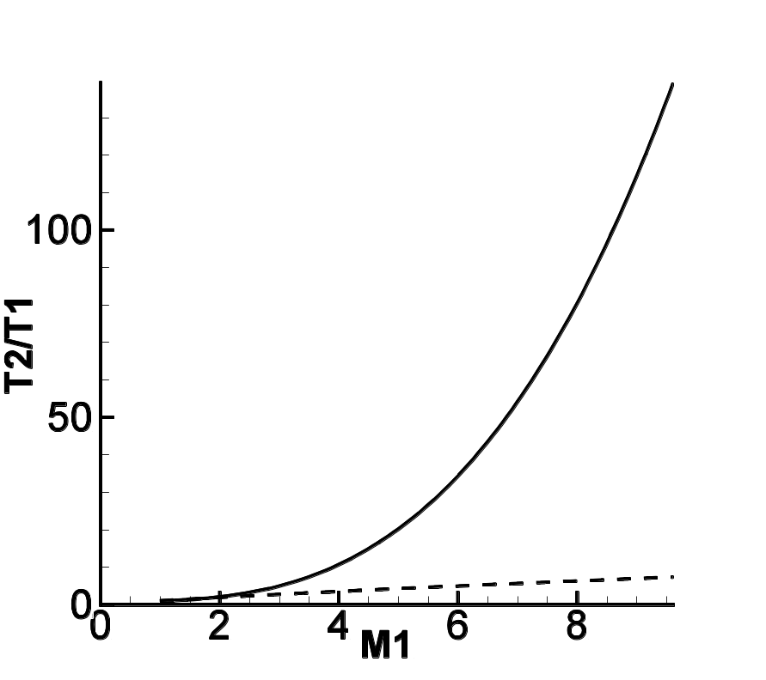
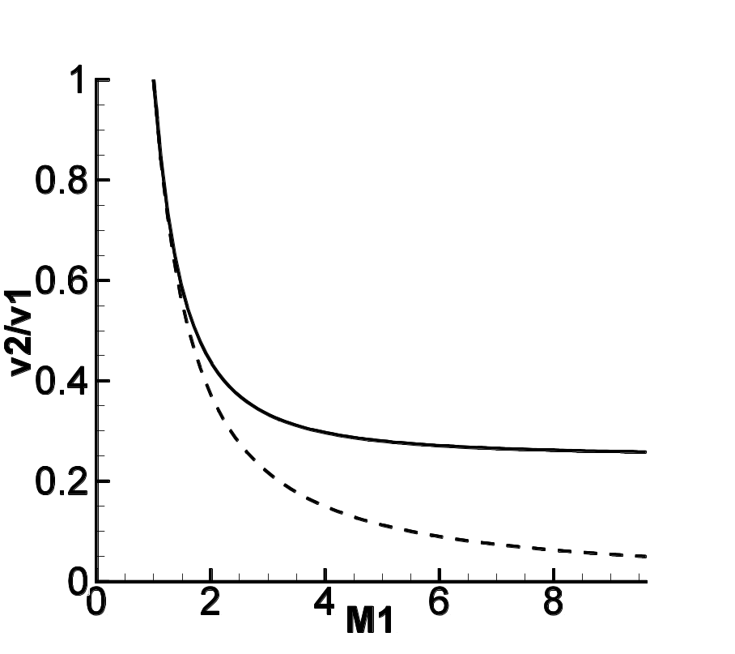

Slide 11
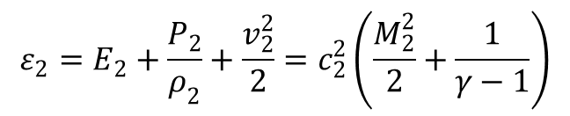
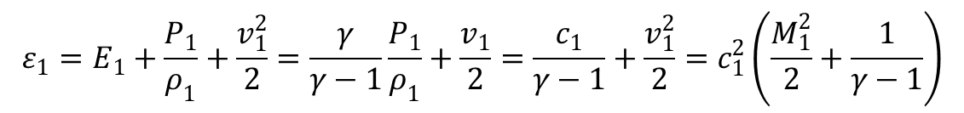
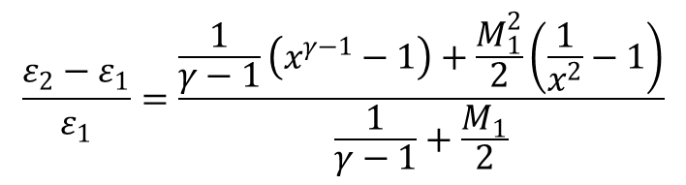

Full energy before the ‘isentropic shock’
$$ε_{1}=E_{1}+\frac{P_{1}}{ρ_{1}}+\frac{v_{1}^{2}}{2}=\frac{γ}{γ−1}\frac{P_{1}}{ρ_{1}}+\frac{v_{1}}{2}=\frac{c_{1}}{γ−1}+\frac{v_{1}^{2}}{2}=c_{1}^{2}\left(\frac{M_{1}^{2}}{2}+\frac{1}{γ−1}\right)$$
Full energy $after$ the ‘isentropic shock’
$$ε_{2}=E_{2}+\frac{P_{2}}{ρ_{2}}+\frac{v_{2}^{2}}{2}=c_{2}^{2}\left(\frac{M_{2}^{2}}{2}+\frac{1}{γ−1}\right)$$
Relative violation of full energy on ‘isentropic shock’
$$\frac{ε_{2}−ε_{1}}{ε_{1}}=\frac{\frac{1}{γ−1}\left(x^{γ−1}−1\right)+\frac{M_{1}^{2}}{2}\left(\frac{1}{x^{2}}−1\right)}{\frac{1}{γ−1}+\frac{M_{1}}{2}}$$
x is implicit function of M₁

Slide 12
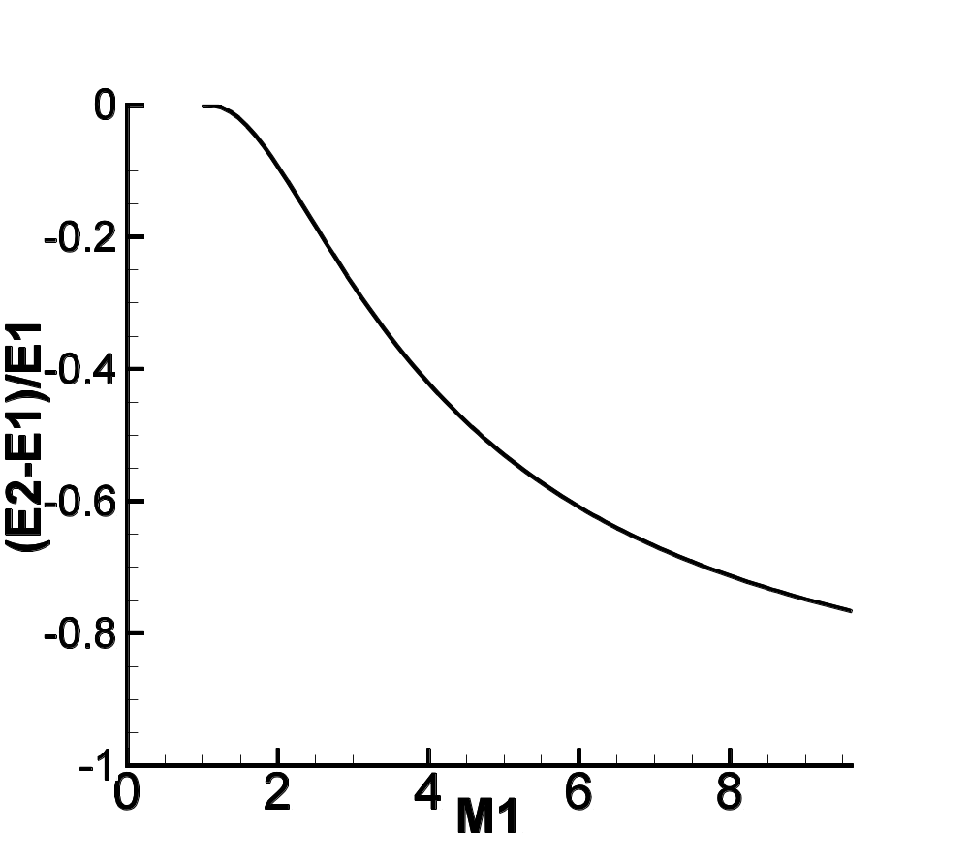
For M1=2, error in energy is more then 20% !

Slide 13
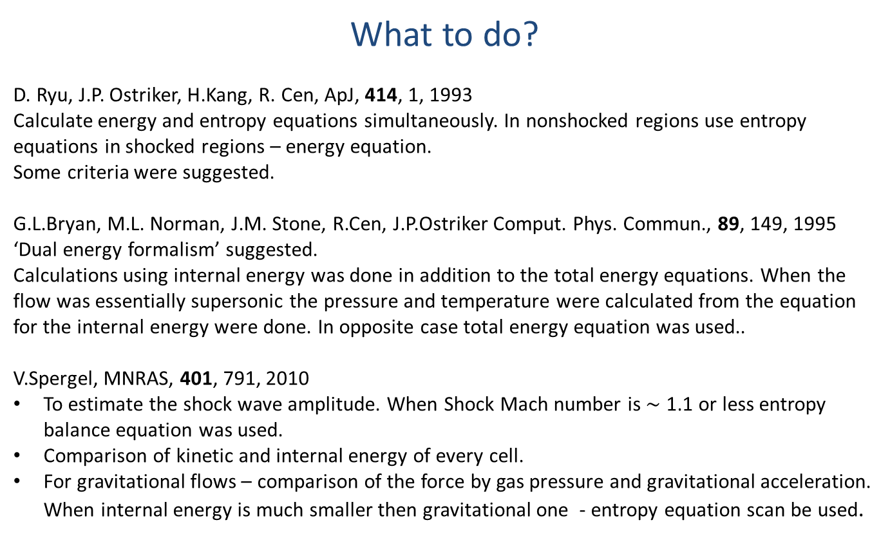
What to do?
D. Ryu, J.P. Ostriker, H.Kang, R. Cen, ApJ, 414, 1, 1993
Calculate energy and entropy equations simultaneously. In nonshocked regions use entropy equations in shocked regions – energy equation.
Some criteria were suggested.
G.L.Bryan, M.L. Norman, J.M. Stone, R.Cen, J.P.Ostriker Comput. Phys. Commun., 89, 149, 1995 ‘Dual energy formalism’ suggested.
Calculations using internal energy was done in addition to the total energy equations. When the flow was essentially supersonic the pressure and temperature were calculated from the equation for the internal energy were done. In opposite case total energy equation was used..
V.Spergel, MNRAS, 401, 791, 2010
To estimate the shock wave amplitude. When Shock Mach number is $∼$ 1.1 or less entropy balance equation was used.
Comparison of kinetic and internal energy of every cell.
For gravitational flows – comparison of the force by gas pressure and gravitational acceleration. When internal energy is much smaller then gravitational one - entropy equation scan be used.

Slide 14
Conclusion
Always try to conserve energy.
Use entropy conservation very carefully.

